Slide 1

The Pittsburgh Theater Hub
Alaina Halbleib

Slide 2
Homepage
Navigation: Home | About | Get Involved | Blog | Contact
Hero Image:
rotating candid show pictures from Pittsburgh area
“Making theater in Pittsburgh, PA accessible”
CTAs
“Get Involved”
“Get back to live theater”
Buttons:
“Watch”
“Join”
Products and Services:
Audition information
“Audition for a show near you!”
“Here you’ll find a collection of all theaters (community, professional, and otherwise) where you can get involved!“
CTA: “Audition Today!”
Image: a Pittsburgh venue
Volunteer Opportunities
Crew Positions
Theater Operations
Upcoming shows and tickets
“What’s playing now?”
“Find upcoming shows and purchase tickets, all in one place”
Location:
“Find a theater near you”
map of local theaters
Blog Previews:
show reviews
The Pittsburgh Theater Hub: Home
Get back to live theater in Pittsburgh-- all in
one place.

Slide 3
About Us
Who We Are
Founded by a native Pittsburgher and ex-theater performer, The Pittsburgh Theater Hub was created by Alaina Halbleib to fulfil her desire to get back to theater. Nowhere else could she find a resource so inclusive and expansive as to what shows she could audition for or go see in the Pittsburgh region. Established in 2025, The Pittsburgh Theater Hub seeks to provide access to all things theater to the Pittsburgh community.
Mission Statement
The Pittsburgh Theater Hub provides a complete guide to theater productions in the Pittsburgh region including audition information and sign ups, show dates and ticket sales, and volunteer opportunities, all to unite the Pittsburgh community and their love for theater.
Community Impact
Participation
Connected over 100 local performers and crew members to shows
Facilitated over 500 ticket sales
Meet Our Founder
Name: Alaina Halbleib
Photo: headshot
Bio: Pittsburgh native and Broadway lover who will find any and every opportunity to consume and/or perform live theater.
Join Our Team
Apply now to join the Pittsburgh Theater Hub team!

Slide 4
Contact + Products and Services
Contact Us!
412-000-0000
info@PittsburghTheaterHub.org
Socials
Audition Information
“Opportunity awaits. Get yourself in the room.”
Upcoming Auditions
Show Title
Type
Show Logo
Description with show and rehearsal dates, audition requirements, character breakdowns, etc.
CTA Button: “Audition Now“
Contact Form
Name:
Email:
Message:

Slide 5
For Immediate Release: March 18, 2025
Contact: Alaina Halbleib
The PGH Theater Hub
412-000-0000
pghtheaterhub@gmail.com
pghtheaterhub.org
Press Release
Community Hub for Theater in Pittsburgh Launches Across Devices Today
Pittsburgh, PA (March 18, 2025) - The PGH Theater Hub launched their website today, featuring resources for all things Pittsburgh Theater.
The site hosts information detailing audition information, ticket sales, upcoming shows, reviews, and more. Visitors can find theaters near them to get involved with or to see their productions.
“We are so excited to launch this resource for everyone in the Pittsburgh community that wants to get back to live theater,” said founder, Alaina Halbleib, this morning.
The PGH Theater Hub values community, knowledge, and entertainment, which combine to inform a community, bring theater-lovers together, and make Pittsburgh Theater accessible.
Halbleib says that she cannot wait to see the community’s response and hopes to grow the site enough to collaborate with Pittsburgh theater makers and spaces.
For more information, please visit pghtheaterhub.org, or call 412-000-0000. Additional materials and information is also available at pghtheaterhub.org.
###

Slide 6
Social Posts
Subject: Community Hub for Theater in Pittsburgh Launches Across Devices Today
x (Twitter)
3, 2 ,1…. LIFTOFF! The Pittsburgh Theater Hub website is officially LIVE NOW! Auditions, show tickets, volunteer opportunities, reviews and so much more-- all in one place. Get back to live theater and visit at the link in bio today! #pghTH
Instagram
On a graphic: “3, 2, 1… LIFTOFF!”
“The Pittsburgh Theater Hub website is officially LIVE NOW! Visit at the link in bio today! #pghth #pghtheater #livetheater”
Facebook
Hero image with mission statement
“The Pittsburgh Theater Hub is officially LIVE! #pghTH

Slide 7
Promotional Email
Subject Line: AUDITION SEASON! New spring auditions just dropped!
Graphic with headline: New Spring Audition Information
It’s that time of year again: audition season. I KNOW, I know, you’re dreading rifling through website after website with listings. Lucky for you, we’ve got audition information all in one place.
Sample Listings:
We have:
Tours
Regional
Professional
Semi-professional
Community theater
Youth/Educational
Stage 62
The Prom
Wed. Apr 23
Riverfront Theater Co.
Freaky Friday (Youth)
Sat. Apr 26 - Sun. Apr 27
Check out auditions near you!

Slide 8
Long Form Video
Pittsburgh Actors on Industry Accessibility and tools like The Pittsburgh Theater Hub
Interview with Pittsburgh Actors, documentary style, on the importance of accessibility as actors.
Introduction:
-single shots of each actor
-clips introducing them: Name, age, where in Pittsburgh they’re from, and current show if any
Topic One:
What was your first show? How old were you? Where? How did you hear about it?
-clips intercut together of answers
Topic Two:
How do you find auditions? Do you think that
method is accessible?
-clips intercut together of answers
Topic Three:
Why is an all in one space like The Pittsburgh Theater Hub beneficial? Do you think it benefits a certain demographic? Could you have benefitted from it? Would your career be in a different place?
Topic Four:
Why is accessibility important? Is the theater industry accessible, in your opinion? How can we change that?
Conclusion:
-any final words or clips that weren’t used previously
-plug on how to access PTH

Slide 9
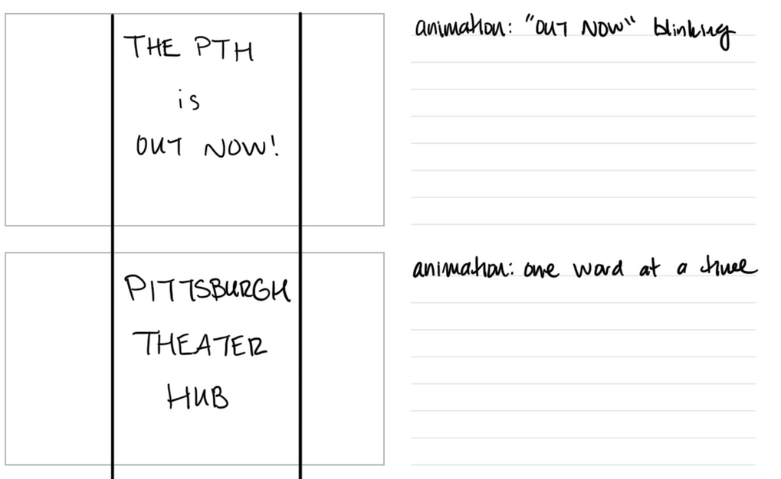
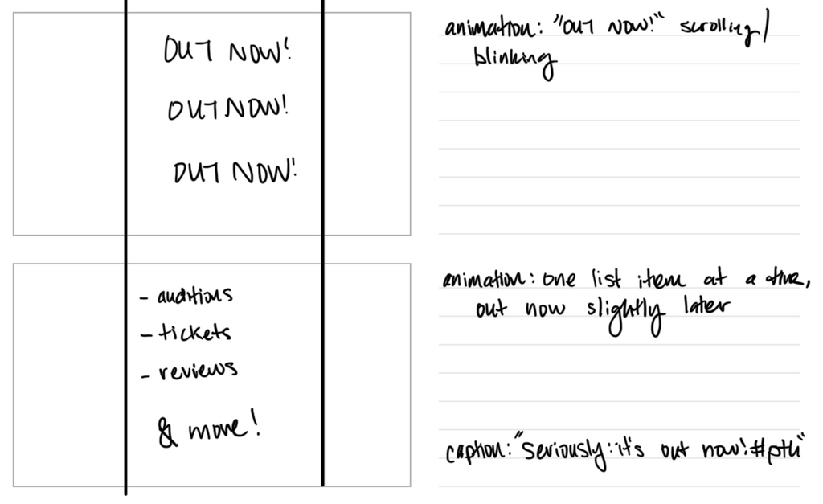
Short Form Video

Slide 10
Podcast
The Pittsburgh Theater Pod ft. William McBridge
William McBridge, actor and Pittsburgh-native joins the Pittsburgh Theater Pod to discuss his latest role and how he got to that point.
Sponsor Message: Today’s episode is sponsored by Belt Box. Belt box is a tool for all performers living in small or shared housing. Take it on tour, practice in your apartment building, or anywhere you need to belt just a bit quieter. Belt Box, available now at beltbox.com. Onto the episode!
Intro: Welcome to the Pittsburgh Theater Pod, brought to you by the Pittsburgh Theater Hub. I’m your host Alaina Halbleib and I am joined today by Pittsburgh Theater icon, William McBridge.
Topic #1: Growing up in Pittsburgh theater scene (10 minutes)
Segue: Let’s shift gears a bit now to your current project… A Chorus Line at the Benedum Center!
Topic #2: New show: A Chorus Line
Can you give the folks at home a little summary of the show?
What role are you playing?
What is your favorite number in the show?
How can we get tickets?

Slide 11
Podcast (Continued)
Topic #3: Game Segment - Broadway Trivia
What is the musical inside of Smash (show and broadway show)?
Bombshell
What childhood duo was stunt cast in Little Shop of Horrors off-Broadway last month?
Liz Gillies and Milo Manheim
What is the longest running show currently on Broadway?
Chicago (90s revival)
Closing
Well thank you so much William for popping into the Pittsburgh Theater Pod! Do you have any parting words for our quests?
CTA
Make sure to tune into PittsburghTheaterHub.com for our blog headed to you guys tomorrow and next Thursday for the next episode of The Pittsburgh Theater Pod! Also be sure to check out Mr. McBridge in A Chorus Line headed to the Benedum Center next week! Bye!

Slide 12
Print Advertisement
Message: Get back to live theater in Pittsburgh
Image: Spotlight on a curtain, text on spotlight.
Goals: get viewership on site, drive engagement, spread the word
Target audience: young adult theater performers in Pittsburgh

